Slide 1

Analysis of India Election 2024 Data using Power BI
Author: Aditya Satheesan
Profile: Data Analyst
Batch: MIP-DA-11

Slide 2
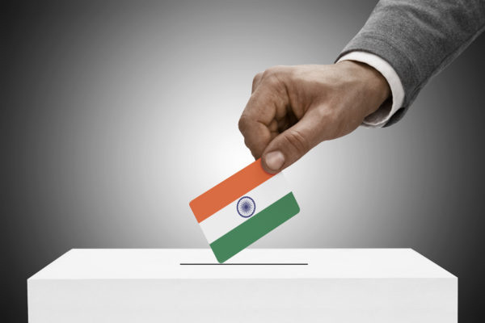
Objective
The primary objective of this project is to conduct a comprehensive analysis of the 2024 election data to extract meaningful insights regarding election results, party performance metrics, and voter behavior trends across different constituencies. By leveraging advanced data visualization tool like Power BI, we aim to develop a dynamic dashboard with interactive visualizations. These analytical tools will enable key stakeholders to:
Understand complex election results with clarity
Evaluate the relative performance of political parties and alliances
Identify significant trends in voter preferences and demographic shifts
Visualize geographical distribution of voters' support
Analyze the impact of various socio-economic factors on voting patterns
By presenting this data in an interactive format, we will facilitate informed decision-making and strategic planning for future political engagements. This analysis will serve as a valuable resource for political analysts, campaign strategists, and policy makers in understanding the complex dynamics of the electoral landscape.

Slide 3

Dataset Description
1. Election Results Data:
2. Party Alliance Data::
Variable | Description
_id | Unique identifier for each record.
State | Name of the state.
Const. No. | Constituency number.
Constituency | Name of the constituency.
Leading Candidate | Name of the leading candidate.
Leading Party | Name of the leading party.
Trailing Candidate | Name of the trailing candidate.
Trailing Party | Name of the trailing party.
Margin | Vote margin between the leading and trailing candidates.
Status | Status of the election result (e.g., Won, Lost, Leading, Trailing)
Variable | Description
Party Name | Name of the political party.
Alliance Name | Name of the political alliance the party belongs to

Slide 4
Tasks
1. Data Integration:
Combine the election results data with the party alliance data to get a comprehensive view of which alliances are leading or trailing in various constituencies.
2. Data Cleaning and Preparation:
Ensure data quality by checking for missing values, inconsistencies, and correcting any errors in the datasets.
3. Data Analysis and Visualization:
Overall Results: Create a summary of the overall election results including the total number of seats won by each party and alliance.
State-wise Analysis: Visualize the performance of leading parties and alliances across different states.
Constituency-wise Analysis: Analyze and visualize the margin of victory/defeat in various constituencies.
Party and Alliance Comparison: Compare the performance of different parties and their respective alliances in terms of seats won, margins, and status.

Slide 5
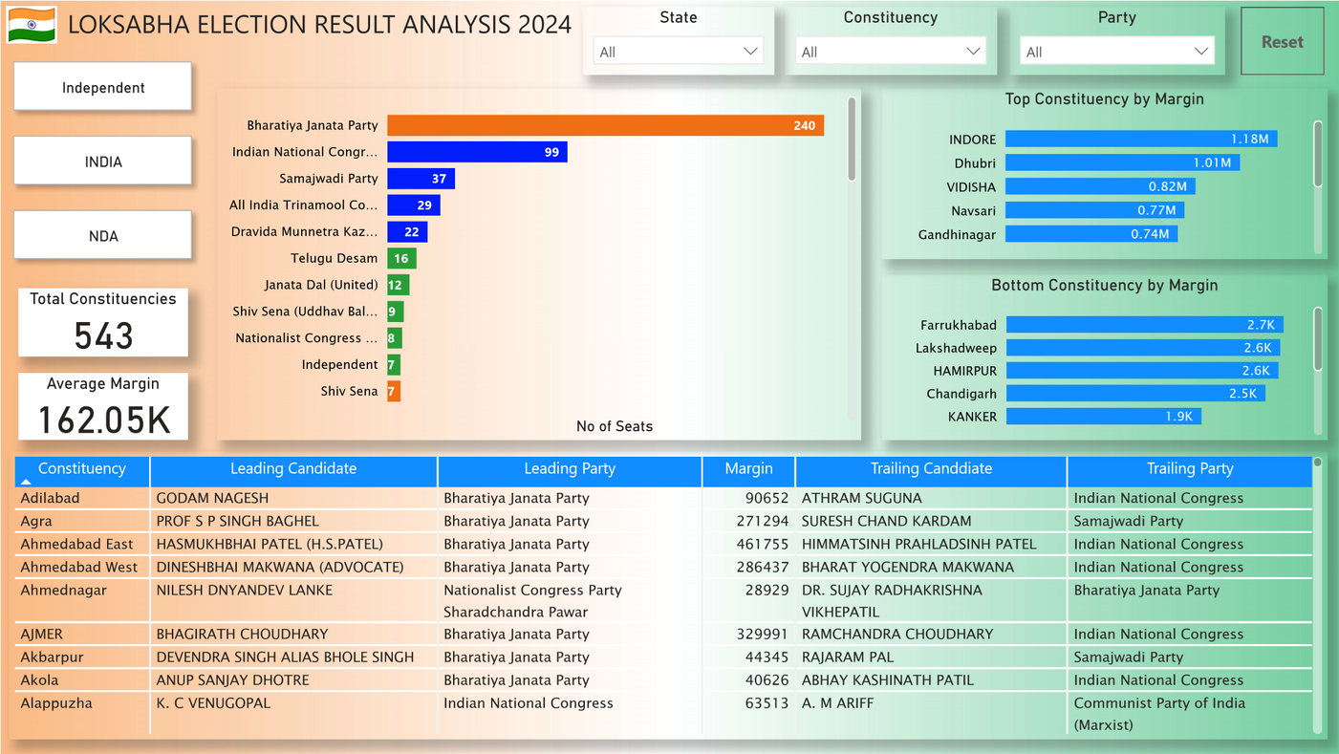
Tasks
4. Interactive Dashboard:
Trend Analysis: Identify and visualize trends in voting patterns, such as regions with high competition (small margins) or dominance by specific parties or alliances.
Create an interactive dashboard that allows users to filter and explore the data by state, constituency, party, alliance, and status.
Include key performance indicators (KPIs) such as total seats won, average margin, and number of constituencies won by alliance.

Slide 6


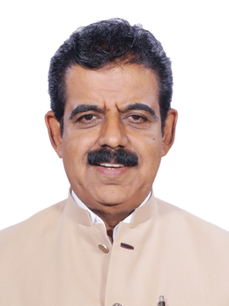
Tasks
6. Insights:
The Alliance NDA won in 253 constituencies with an Avg Margin of 187K
The Alliance INDIA won in 208 constituencies with an Avg Margin of 138K
Rest of the parties won in 82 constituencies with an Avg Margin of 146K
BJP, Indian National Congress, Samajwadi Party are the top 3 parties that have won the most seats.
BJP won in 240 constituencies,
INC in 99 constituencies
Samajwadi Party won in 99 constituencies.
Shankar Lalwani of BJP was the candidate who won with the highest margin i.e 1.17 million votes in the Indore constituency of Madhya Pradesh.
Ravindra Dattaram Waikar of Shiv Sena was the candidate who won with the lowest margin i.e 48 votes in the Mumbai North West constituency of Maharashtra.

Slide 7
Tasks
7. Recommendations:
Address Critical Policy Concerns
a) Prioritize key voter issues including healthcare reform, economic growth, educational advancement, and national security
b) Develop and communicate comprehensive, data-driven policy proposals with clear implementation strategies
c) Tailor messaging to resonate with diverse demographic groups and regional concerns
Enhance Voter Participation
Implement a multi-faceted approach to increase voter turnout:
a) Streamline voter registration processes through digital platforms and community outreach
b) Establish a robust network of transportation services to polling locations
c) Promote and facilitate early voting options to maximize accessibility
Intensify Grassroots Mobilization
Expand and optimize the campaign's ground operations:
a) Recruit and train a larger corps of volunteers for targeted canvassing efforts
b) Implement sophisticated phone and text banking systems with personalized messaging
c) Organize strategic local events to foster community engagement and solidify support

Slide 8
Tasks
7. Recommendations:
Leverage Strategic Partnerships
Cultivate relationships with influential figures across various sectors:
a) Engage respected community leaders and local stakeholders
b) Secure endorsements from relevant industry experts and thought leaders
c) Collaborate with public figures who align with campaign values to amplify messaging
Implement Proactive Opposition Research and Response Strategies
a) Establish a dedicated team for continuous monitoring and analysis of opponent activities
b) Develop rapid response protocols to address misinformation and negative campaigning
c) Craft preemptive messaging strategies to neutralize potential opposition attacks
Optimize Data-Driven Decision Making
a) Utilize advanced analytics to inform campaign strategy and resource allocation
b) Conduct regular polling and focus groups to gauge public sentiment and refine messaging
c) Implement real-time tracking of key performance indicators to enable agile campaign management

Slide 9


Thank You!
DO YOU HAVE ANY QUESTIONS?
Mail me at:
adityasatheesan22@gmail.com
CREDIT: SlideEgg created this PowerPoint template.

